Slide 1
What Is a Computer?
How is a computer defined?
  Electronic device operating under the control of instructions stored in its own memory
    Processes data into information
      Data that is organized, meaningful, and useful
    Accepts data
      Raw facts
p. 3
Next

Slide 2
Advantages and Disadvantages of Using Computers
What are the advantages of using computers?
Reliability
Speed
Consistency
Storage
Communications
p. 5
Next

Slide 3
Advantages and Disadvantages of Using Computers
What are the disadvantages of using computers?
Violation of
Privacy
Impact on
Labor Force
Health Risks
Impact on
Environment
p. 5
Next

Slide 4
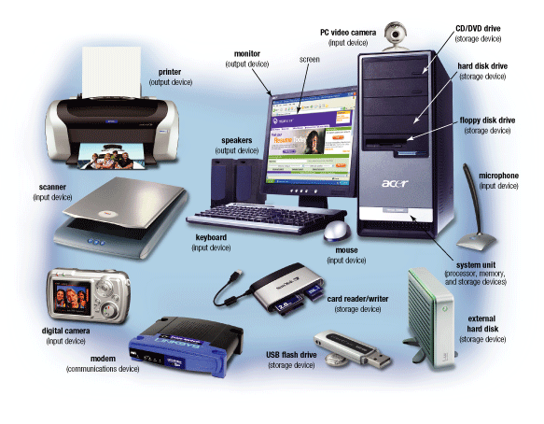
The Components of a Computer
What is an input device?
Hardware used
  to enter data
  and instructions
Click to view Web Link,
click Chapter 1, Click Web Link
from left navigation,
then click Input Devices
below Chapter 1
p. 6 Fig. 1-3
Next

Slide 5
The Components of a Computer
What is an output device?
Hardware that
  conveys information
  to one or more
  people
Click to view Web Link,
click Chapter 1, Click Web Link
from left navigation,
then click Output Devices
below Chapter 1
p. 7 Fig. 1-3
Next

Slide 6
The Components of a Computer
What is the system unit?
Box-like case
  containing
  electronic
  components
  used to process
  data
p. 7 Fig. 1-3
Next

Slide 7
The Components of a Computer
What are two main components on the motherboard?
  Central Processing Unit (CPU)
    Also called a processor
    The electronic component that interprets and carries
    out the basic instructions that operate the computer
  Memory
    Consists of electronic components that store
    instructions waiting to be executed and data needed by
    those instructions
p. 7
Next

Slide 8
The Components of a Computer
What is storage?
  Holds data, instructions, and information
  for future use
  Storage media
      Physical material on which data, instructions,
      and information are stored
  Storage device
      Records and retrieves items to and from
      a storage medium
p. 7
Next

Slide 9
The Components of a Computer
What is storage media?
Hard Disks
Floppy Disks
CDs
Memory Cards
USB Flash Drives
DVDs
p. 7
Next

Slide 10
The Components of a Computer
What is a storage device?
Records (writes)
items to storage
media
Retrieves
(reads)
items from
storage
media
Often function
as a source
of input
p. 7
Next

Slide 11
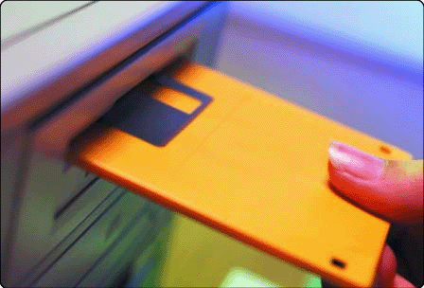
The Components of a Computer
What is a floppy disk?
  Thin, circular,
  flexible disk
  enclosed in rigid
  plastic shell
p. 7
Next

Slide 12
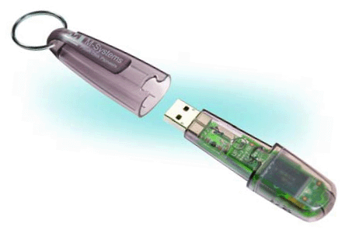
The Components of a Computer
What is a USB flash drive?
  Provides much
  greater storage
  capacity than a
  floppy disk or
  Zip® disk
  Small and
  lightweight enough
  to be transported
  on a keychain or
  in a pocket
p. 7
Next

Slide 13
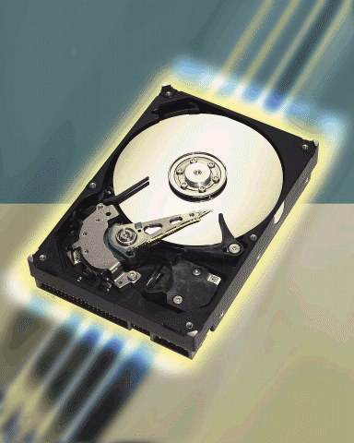
The Components of a Computer
What is a hard disk?
  Provides greater storage
  capacity than a
  floppy disk, Zip disk, or
  USB flash drive
  Most are housed inside
  of the system unit
p. 7 Fig. 1-4
Next

Slide 14
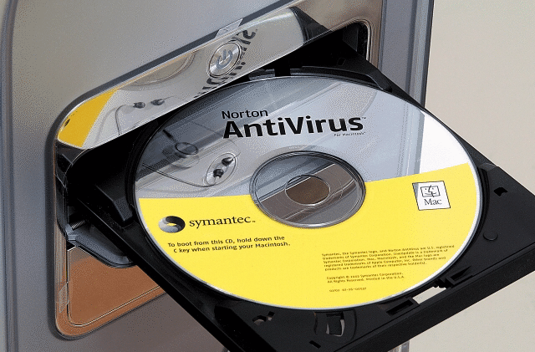
The Components of a Computer
What is a compact disc?
  Flat, round, portable metal disc
    CD-ROM
    DVD-ROM
p. 7 Fig. 1-5
Next

Slide 15
The Components of a Computer
What is a communications device?
Hardware component that
enables a computer to
send and receive data, instructions,
and information
Occurs over cables, telephone
lines, cellular radio networks,
satellites, and other
transmission media
Click to view Web Link,
click Chapter 1, Click Web Link
from left navigation,
then click Communications Devices below Chapter 1
p. 8
Next

Slide 16
Networks and the Internet
A network is a collection of computers and devices connected together
To share
Resources
Hardware
devices
Software
programs
Data
To save
time
and
money
Information
p. 8
Next

Slide 17
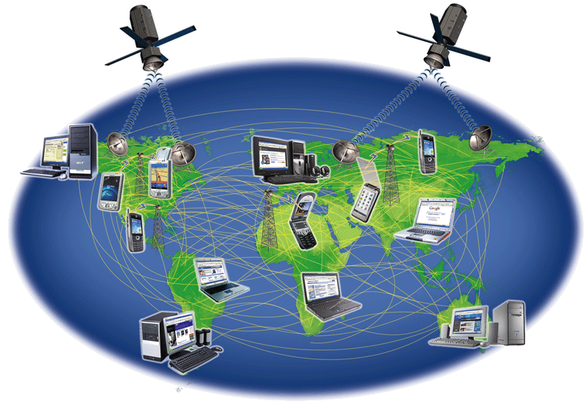
Networks and the Internet
What is the Internet?
  Worldwide collection of networks that connects
  millions of businesses, government agencies, educational institutions, and individuals
Click to view Web Link,
click Chapter 1, Click Web Link
from left navigation,
then click Internet
below Chapter 1
p. 8 Fig. 1-6
Next

Slide 18
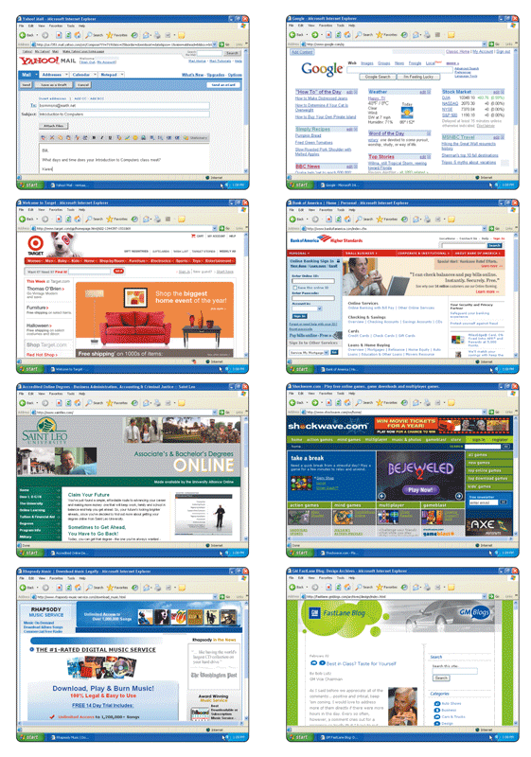
Networks and the Internet
Why do users access the Internet?
  Communications
Information
Shopping
Banking and Investing
Classes
Entertainment
7. Download Music
8. Share Information
p. 9 Fig. 1-7
Next

Slide 19
Networks and the Internet
What is the Web?
  Billions of documents, called Web pages, available to anyone connected to the Internet
A Web site is
a collection of
related Web pages
You can share
information by
creating Web pages
or posting photos on
a photo sharing
community
A podcast is
recorded audio
stored on a Web site
that can be
downloaded
A Web page contains
text, graphics, audio,
video, and links to
other Web pages
A blog consists of time-
stamped articles
Click to view
Web Link,
click Chapter 1,
Click Web Link
from left navigation,
then click Blogs below Chapter 1
p. 10
Next

Slide 20
Computer Software
What is software?
Consists of a series
of instructions that
tells the computer
what to do
Also called a
program
p. 10
Next

Slide 21
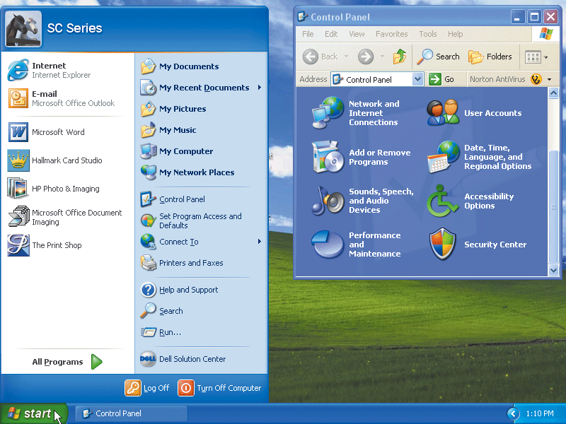
Computer Software
What is a graphical user interface (GUI)?
  Allows you to interact with the software using graphics and icons
  Controls how you enter data and how the screen displays information
p. 10 Fig. 1-8
Next

Slide 22
Computer Software
What is system software?
  Programs that control or maintain the operations of the computer and its devices
Operating System (OS)
is a set of programs
that coordinates all
activities among
computer hardware
devices and allows
users to run
application software
Utility Programs allow the user to
perform maintenance-type tasks
usually related to managing a
computer, its devices or its programs
p. 10 - 11
Next

Slide 23
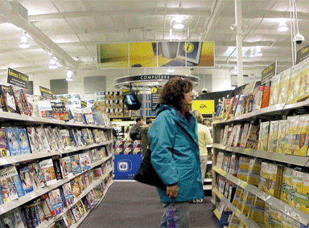
Computer Software
What is application software?
  Programs that perform specific tasks for users
Word
Processing
Spreadsheet
Database
Presentation
Graphics
Click to view Web Link,
click Chapter 1, Click Web Link
from left navigation,
then click Application Software below Chapter 1
p. 11 Fig. 1-9
Next

Slide 24
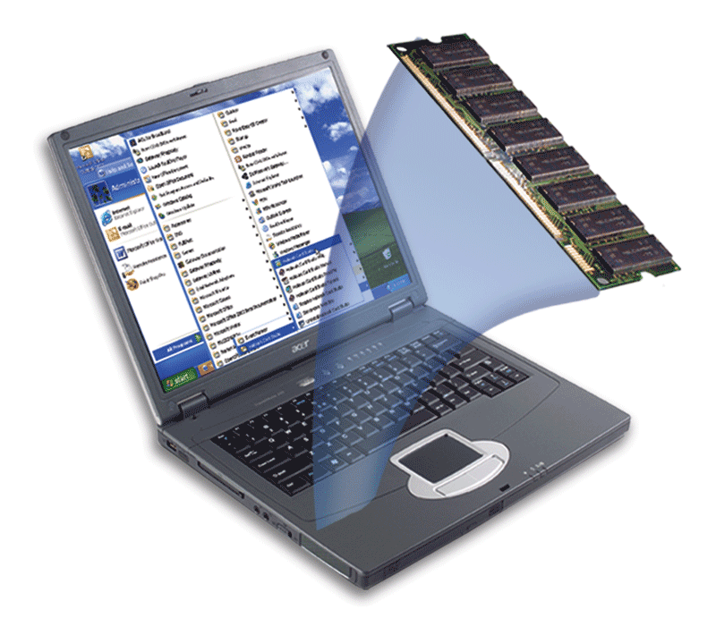
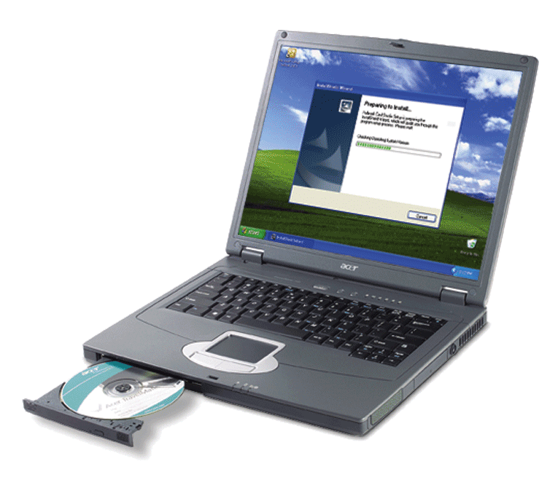
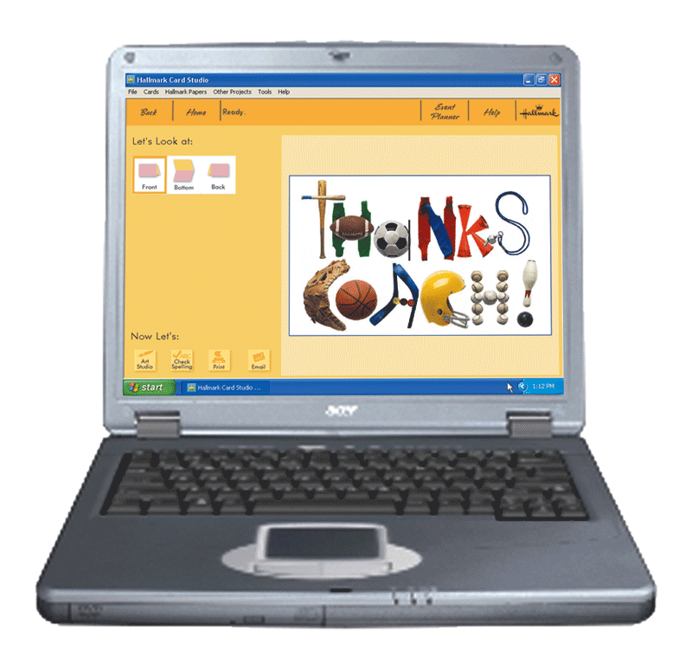
Computer Software
How do you install and run programs?
Step 1: INSTALL
When you insert a greeting card program disc
in the CD drive for the first time, the computer
begins the procedure of installing the greeting
card program on the hard disk.
Step 3: USE
The greeting card program executes. Using this program, you can create custom greeting cards.
Step 2: RUN
Once installed, you can instruct the computer to run the greeting card program. The computer transfers instructions from the hard disk to memory.
p. 11 - 12 Fig. 1-10
Next

Slide 25
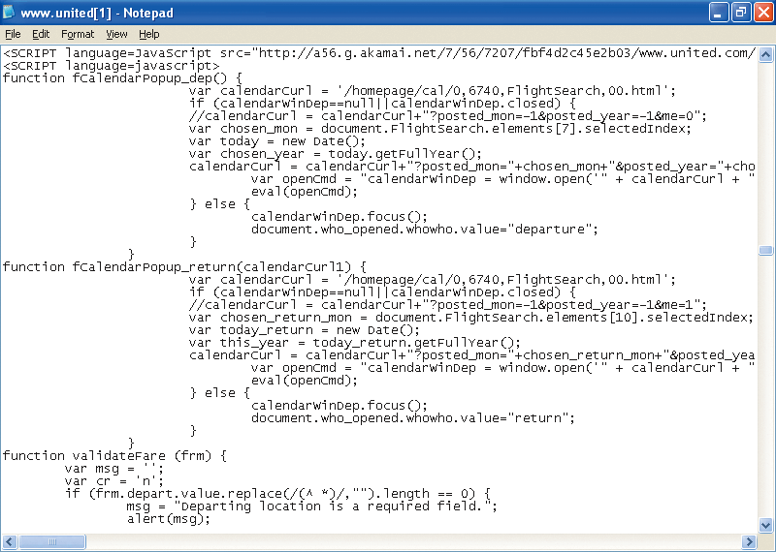
Computer Software
What is a programmer?
  Someone who develops
  application or system software
    Programmer writes
    the instructions to
    direct the computer to
    process data into
    information
p. 12 Fig. 1-11
Next

